Slide 1
The Upanzi Republic: A Multi-DPI Government Subsidy Program Demo
Upanzi Network

Slide 2
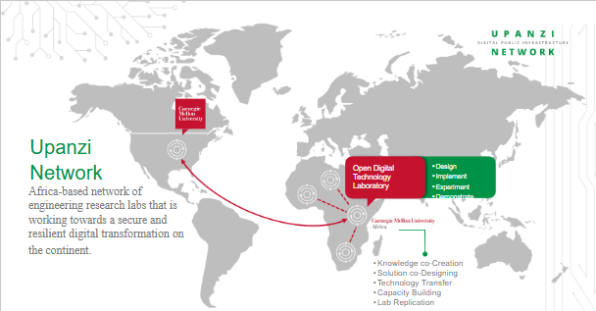

Slide 3
Upanzi contd
…focuses on creating, testing, innovating, and assisting in implementing digital technologies at scale such as identity, payments, cybersecurity, cloud computing, data governance, artificial intelligence and machine learning, and influencing technology policy recommendations to support low- and middle-income countries.

Slide 4
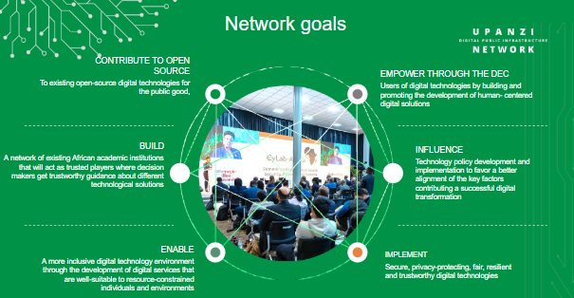

Slide 5

Upanzi workstreams
DPG & DPI
Data
Healthcare
Connectivity
Cybersecurity
Capacity building
Technology & Society

Slide 6
Upanzi national subsidy program use case
Seamless integration of three open-source DPIs:
MOSIP (Digital Identity)
Mojaloop (Interoperable Payments)
Mifos (Core Banking)
Middleware connects these systems via Upanzi Program Management System (UPMS).

Slide 7
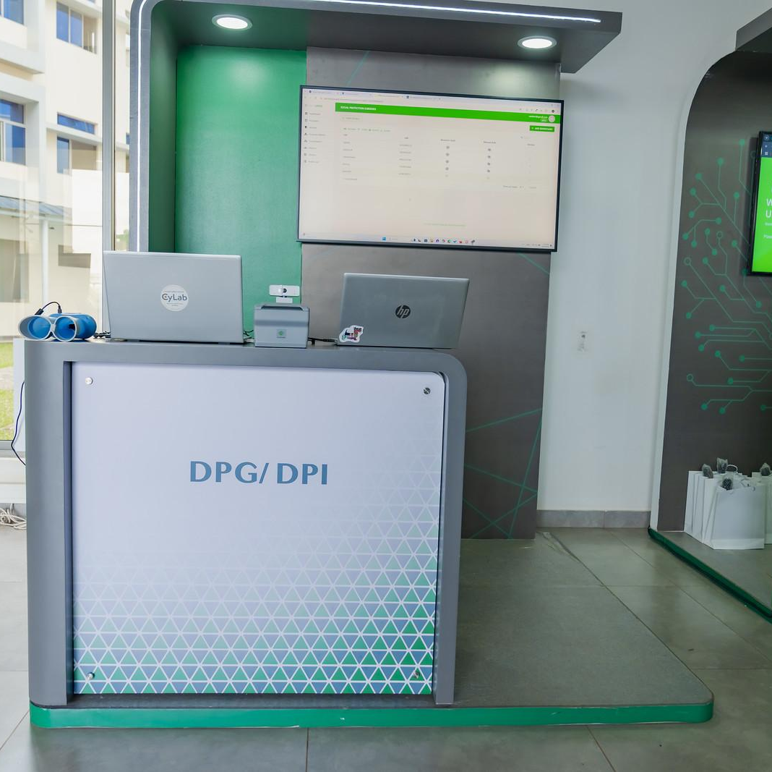
MOSIP - Digital Identity
Citizens register to receive a digital ID.
Digital ID ensures secure, verified access to subsidy programs.
Middleware authenticates users through Upanzi program management system (UPMS).

Slide 8
Mifos - Core Banking
Acts as the backend core banking system.
Manages citizen bank accounts, financial records, and transaction histories.
Integrated through Mojaloop APIs for interoperable payments.

Slide 9
Mojaloop - Payment Interoperability
Enables citizens to link bank accounts (Mifos) using Mojaloop's 3rd Party Payment Initiation (3PPI) APIs.
Provides seamless, real-time transaction processing across financial institutions.

Slide 10
Mojashop Application
Custom-built vendor-client application for subsidy distribution.
Citizens purchase subsidized goods, verified through UPMS.
Transactions processed securely via Mojaloop and Mifos integration.

Slide 11
Demo !

Slide 12
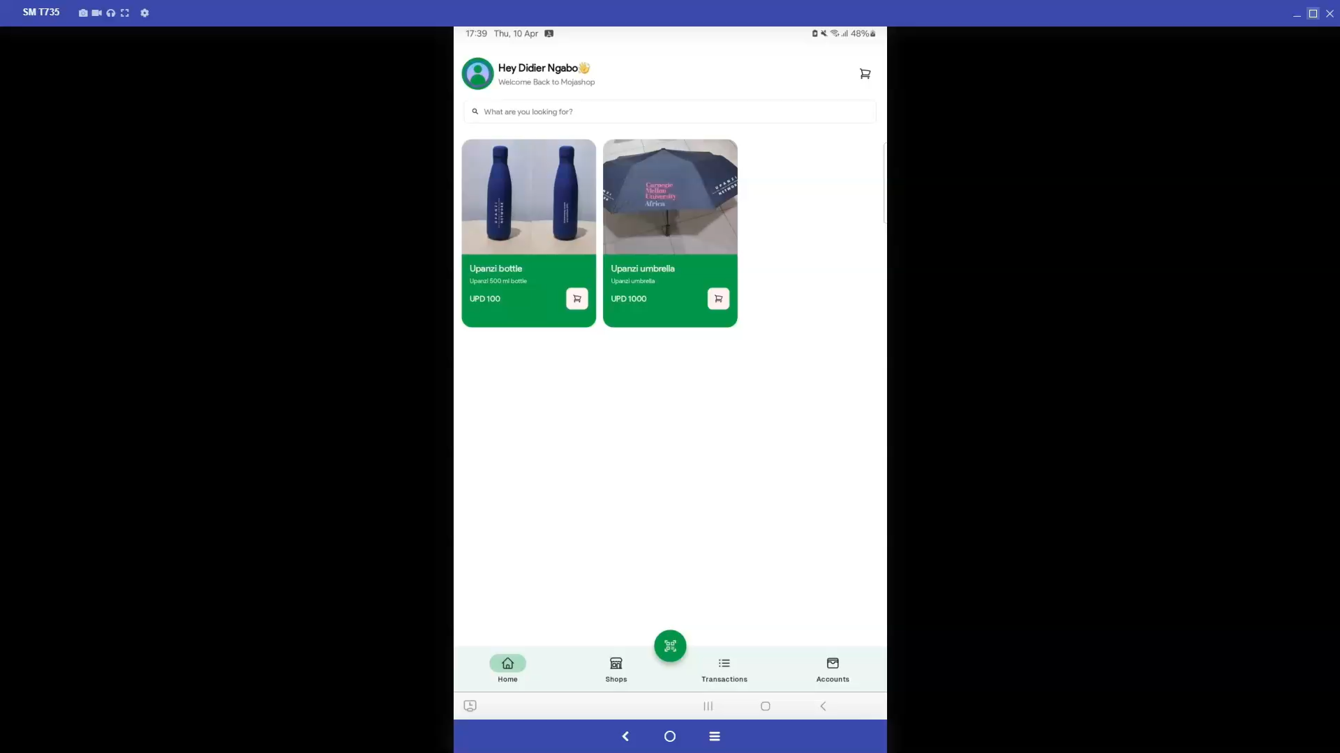

Slide 13
🌟 Thank You, Mojaloop Community 🌟
We extend our heartfelt gratitude to the Mojaloop Community for your unwavering support and commitment to financial inclusion.
A special thank you to:
Sam Kummary – for your direction, and continued encouragement.
Elijah Okello – for your hands-on guidance, technical support, and insightful feedback.
Your contributions have been instrumental in our journey with Mojaloop.

Slide 14
Future work
As we build on the momentum of our Mojaloop journey, here’s what’s next:
Open-Sourcing Mojashop We plan to publish the Mojashop codebase to the open-source community—sharing our work to help others integrate Mojaloop more easily.
Active Contribution to Mojaloop Workstreams We're committed to giving back by actively participating in Mojaloop workstreams, contributing ideas, code, and collaboration.
Exploring Cross-Border Use Cases We aim to replicate and adapt our setup at a regional level, demonstrating how Mojaloop can power inclusive cross-border payments across Africa.

Slide 15

Thank you
dngabo@andrew.cmu.edu
cylab-africa-kigali@andrew.cmu.edu

